Slide 1

Azure AD for developers
by Andrei Dzimchuk (@dzimchuk)

Slide 2
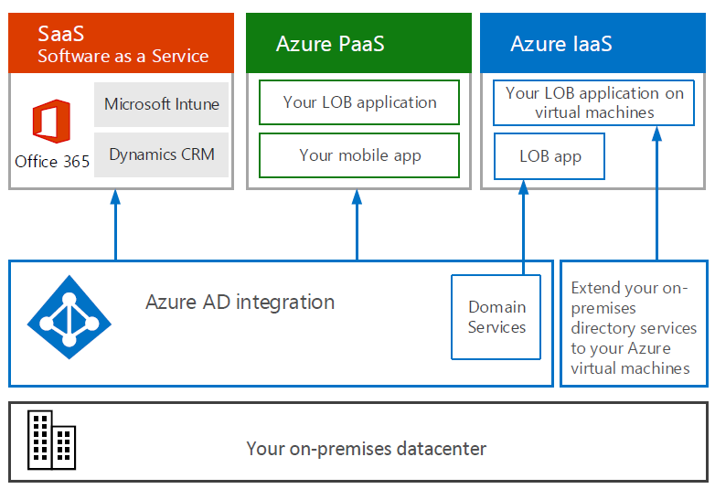

Slide 3

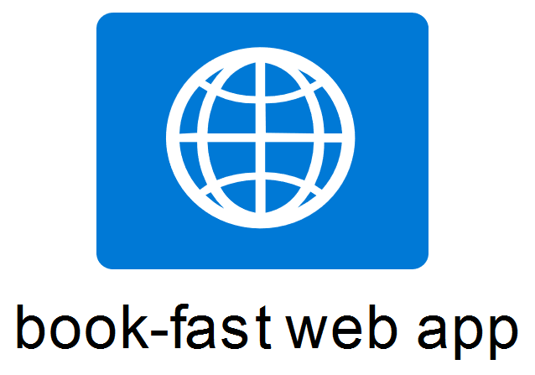

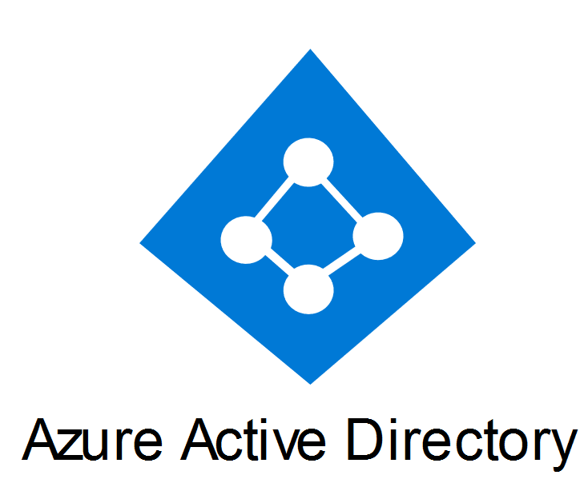
OpenID Connect

Slide 4

OpenID Connect

Slide 5


OpenID Connect

Slide 6
Request

Slide 7
Request
WWW-Authenticate: Bearer

Slide 8
Request

Slide 9
Request
HTTP/1.1 200 OK
Get metadata

Slide 11
HTTP/1.1 302 Found
code
id_token

Slide 12
HTTP/1.1 302 Found
access_token
code
code
id_token

Slide 13
HTTP/1.1 302 Found
Request
access_token
code
code
id_token

Slide 14
ADAL (https://github.com/AzureAD)

Slide 15
ADAL (https://github.com/AzureAD)
Azure AD protocol dialect

Slide 16
ADAL (https://github.com/AzureAD)
Azure AD protocol dialect
Token cache

Slide 17
ADAL (https://github.com/AzureAD)
Azure AD protocol dialect
Token cache
Token refresh

Slide 18
Resources
Official documentation:
https://azure.microsoft.com/en-us/documentation/services/active-directory/
https://azure.microsoft.com/en-us/documentation/services/active-directory-b2c/
Modern Authentication with Azure Active Directory for Web Applications (by Vittorio Bertocci)
https://dzimchuk.net/category/azure+active+directory

